Slide 1
Mineral Metabolism
Dr.Deepa.G.S
Associate Professor
Dept.of Physiology

Slide 2
IODINE
Total Iodine content in body -20 mg
Thyroid gland-80%
Muscle, Salivary glands, Ovaries-20%
Biochemical function
Synthesis of thyroid hormones-T3 and T4

Slide 3
IODINE
Daily requirement
Adults-100-150 µg/day
Pregnant women-µ200 g/day
Sources:
Seafoods, drinking water, vegetables,fruits
Absorption-From small intestine
Storage-80% as iodothyroglobulin in thyroid gland
Excretion-Mostly through kidney
Other modes of excretion- saliva, bile, skin, milk in
lactating women

Slide 4
IODINE
Plasma concentration-4-10mg/dl as protein bound iodine(PBI)
Disease states
Simple goiter
Toxic goiter

Slide 5
IODINE
Goitrogens
Cassava, maize, millet, bamboo shoots, sweet potatoes, beans
Cabbage and tapioca contain thiocynate which inhibits iodine uptake by thyroid
Mustard seeds contain thiourea which nhibits iodination of thoglbulin

Slide 6
Sodium
Chief cation of ECF
Total body sodium-4000 mEq
Bones-50%
ECF-40%
Soft tissues-10%
Plasma sodium-135-145 mEq/l

Slide 7
Sodium-Biochemical functions
Acid base balance
Maintenance of osmotic pressure and fluid balance
Normal muscle irritability and cell permeability
Sodium is involved in intestinal absorption of glucose, galactose and amino acids
Initate heart beat

Slide 8
Sodium-Daily requirements
Normal individuals-5-10g/day
Family history of hypertension-less than 5g/day
Patients of hypertension-1g/day
10 g of NaCl contains 4 g of Na

Slide 9
Sodium
Source
Major source:Cooking salt
Bread,Whole grains,leafy vegetables,nuts,eggs and milk
Absorption-GI tract
Excretion-Regulated at the distal tubules by
aldosterone
Kidneys conserve sodium-99% reabsorbed

Slide 10
Sodium-Disease states
Hyponatremia
Causes:
Diarrhea
Vomiting
Chronic renal diseases
Adrenocortical insufficiency
Addison’s disease
Manifestations: reduced Bp, circulatory failure

Slide 11
Sodium-Disease states
Hypernatremia
Causes
Hyperactivity of adrenal cortex
Prolonged adminstration of cortisone, ACTH and sex hormones
Dehydration
Pregnancy, excessive intake of salt
Manifestations:Dry mucus membrane, fever,
thirst, restlessness

Slide 12
IRON
Total body content-3-5g
Erythrocytes-75% as hb
Muscle- 5% as myoglobin
Ferritin-15%
Heme-most predominant iron containing
substance and constituent of several proteins or
enzymes-hemoglobin, myoglobin, cytochromes,
Xanthine oxidase, catalase, tryptophan
pyrrolase, peroxidase

Slide 13
IRON
Non heme iron-Transferrin, ferritin,hemosiderin
Biochemical functions
Hemoglobin, myoglobin-transport of oxygen and Co2
Cytochromes and certain non heme proteins-
Electron transport chain and oxidative
phosphorylation
Peroxidase-Phagocytosis
Immunocmpetence

Slide 14
Iron-Daily Requirements
Average -20mg/day
Adult man-10mg/day
Menstruating woman-18mg/day
Pregnant and lactating woman-40mg/day

Slide 15
Iron-Sources
Rich sources-Organ meats- liver, heart, kidney
Good sources-Leafy vegetables, pulses, cereals,
fish, apples, dried fruits, molasses
Poor Sources-Milk, Wheat, polished rice

Slide 16
Iron- Absorption
Absorption: stomach and duodenum
Normal people-10%absorbed
Form of iron in food- ferric (Fe³⁺)
HCl in gastric juice releases iron from food
Reducing substances Vitamin C and cysteine
convert Ferric (Fe³⁺) to ferrous (Fe²⁺)

Slide 17
Iron- Absorption
Factors affecting absorption
Acidity, ascorbic acid and cysteine promotes
absorption
Iron deficiency anemia Fe absorption increased to 2-10 times that of normal
Small peptides and amino acids favor iron uptake
Phytate (cereals) and oxalates(leafy vegetables) interferes Fe absorption

Slide 18
Iron- Absorption
Diet with high phosphate content, calcium and lead decreases Fe absorption
Malabsorption syndrome –impaired absorption
Surgical removal of stomach and intestine
absorption severely impaired

Slide 19
https://www.slideshare.net/YESANNA/iron-metabolism-42380942

Slide 20
Iron –one way substance
Minimal loss from body-less than1mg/day
through bile, sweat, hair and not excreted
through urine
Entry of Iron is controlled at the absorption level

Slide 21
Iron-Disease states
Iron deficiency anemia
Inadequate intake
Defective absorption
Chronic blood loss
Repeated pregnancies
Hook worm infestations
Strict vegetarians
Microscopic appearance
Microcytic Hypochromic anemia

Slide 22
Iron deficiency Anemia
Clinical manifestations
Level less than 10g-Apathy(uninterested in
surroundings), sluggish metabolism
Atrophy of gastric epithelium-achlorhydria
Atrophy of epithelium of oral cavity and oesophagus- plummer Wilson syndrome
Impaired attention, irritability, lowered memory and poor scholastic performance

Slide 23
Iron deficiency Anemia
Laboratory findings
Serum iron level-120 µg/dl
Total Iron Binding capacity-400µg/dl
Serum ferrtin level-20-250ng/ml

Slide 24
Iron deficiency Anemia
Treatment
Oral iron supplementation
Pregnant women-100mg of iron +500µg of folic
acid
Children-20mg of iron+100µg of folic acid
Vitamin C for easy absorption
Vitamin E-to prevent free radical generation
from unabsorbed iron

Slide 25
Iron toxicity
Hemosiderosis
Excessive iron in body.
Hemosiderin pigments are golden brown
granules seen in spleen and liver
Causes
Repeated blood transfusion(inHemophilia)
Commonly observed in Bantu tribes due to their diet, corn and cooking in iron pot-Bantu siderosis

Slide 26
Iron-Disease states
Hemochromatosis
Rare disease where hemosiderin is directly deposited in the tissues such as
in liver- cell death leading to cirrhosis of liver
In pancreas- cell death leading to Diabetes
spleen, and skin
Deposits under skin-Bronzed-pigmentation of skin-Hemochromatosis
Bronze diabetes-Triad of cirrhosis, hemochromatosis and diabetes

Slide 27
Calcium
Total Calcium in body :1-1.5Kg
Bones-99%
ECF-1%
Sources:
Best sources-Milk and milk products
Good sources-Beans ,Leafy vegetables, fish,
cabbage, egg yolk

Slide 28
Calcium-Biochemical Functions
Development of bones and teeth
Muscle contraction
Blood coagulation
Nerve transmission
Membrane integrity and permeability
Activation of enzymes

Slide 29
Calcium-Biochemical Functions
Calmodulin mediated action
Intracellular mesenger
Release of hormones
Secretory processes
Action on heart

Slide 30
Calcium-Daily requirements
Adult men and women-800mg/day
Women during pregnancy ,lactation and menopause-1,5g/day
Children-0.8-1.2g/day
Infants-300-500mg/day

Slide 31
Calcium-Absorption
Site:Duodenum
Factors promoting
Vitamin D
Parathyroid hormone
Low acidity
Lactose
Arginine and lysine

Slide 32
Calcium-Absorption
Factors inhibiting
Phytates and oxalates
High phosphate content
Free fatty acids
Alkaline condition
High dietry fibers

Slide 33
Calcium
Plasma Calcium-9-11mg/dl
5mg/dl-Ionized form
1mg/dl-association with citrate or phosphate
4-5mg/dl-Bound to proteins
Excretion:
Partly through kidneys
mostly through intestines

Slide 34
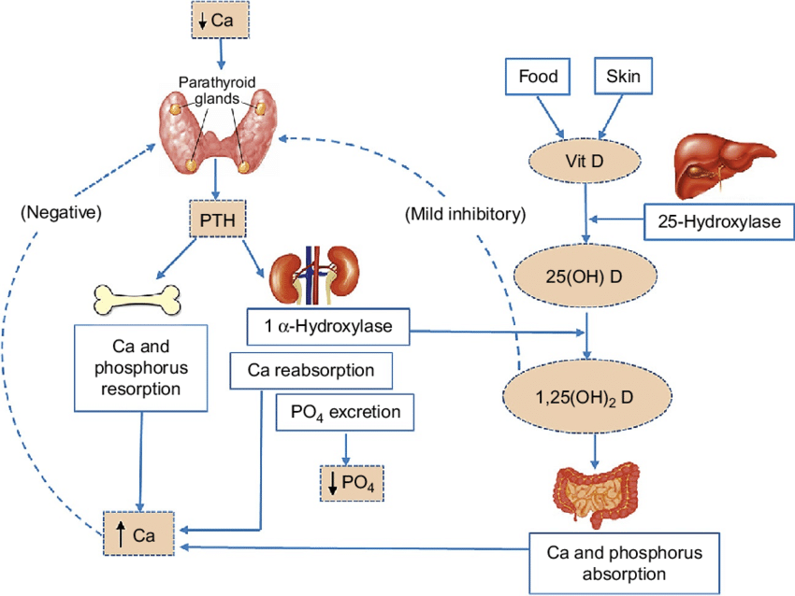
Calcium-Factors regulating
Calcitriol
Parathyroid hormones
Calcitonin
https://www.researchgate.net/figure/Schematic-of-calcium-homeostasis-Solid-line-represents-stimulatory-interaction-dashed_fig1_318961612

Slide 35
Calcium-Disease states
Hypocalcemia-serum Ca below 7mg/dl-Tetany
Cause:Hypoparathyroidism
Osteoporosis- Demineralization of bones
Cause:decreased calcitriol formation in old age
Deficiency of sex hormones in women
Rickets-low Vit.D

Slide 36
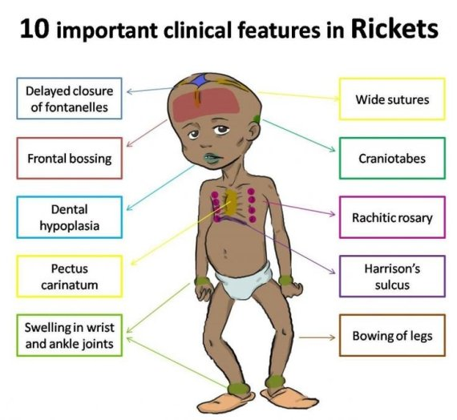
Calcium-Disease states

Slide 37
Calcium-Disease states
Hypercalcemia
Cause:Hyperparathyroidism

Slide 38
Reference:
Biochemistry,U Satyanarayanan,U Chakrapani,Third edition
Textbook of Biochemistry for medical students,DM Vasudevan,Sreekumari S,Kannan Vaidyanathan,Seventh edition

Slide 39
Commonly asked questions
Hypocalcemia
Iron deficiency anemia
Functions of Calcium
Iron-Biochemical Functions and deficiency

Slide 40
Thank you

